Slide 1
REPORT
- SSN VISHNU

Slide 2
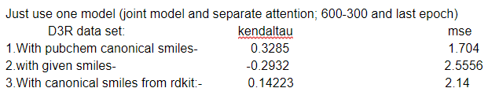
Using different representations for compound
The obtained results were better when using canonical smiles from pubchem than the other representations. So,it is used for representing compound for future purposes.

Slide 3
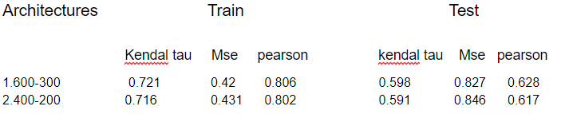
Effect of layer width on affinity values
It is observed that when depth of the network is kept constant the model performance increases with increase in its width but the width shouldn’t be too high and should be between input’s width and output width.

Slide 4
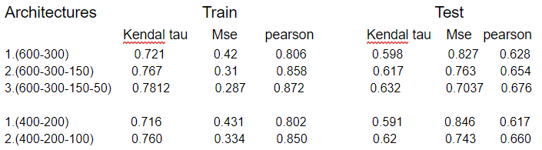
Effect on depth on affinity values
It can be observed that as the depth of the network increases the error decreases by a significant amount .But the depth shouldn’t be too more as it increases the time required for training.

Slide 5
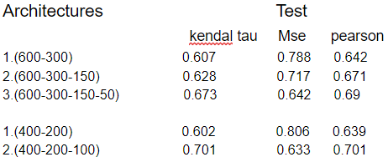
Using mean of last five epochs results
By using mean of last five epochs the models gave better performance and the error improved by a significant amount.

Slide 6
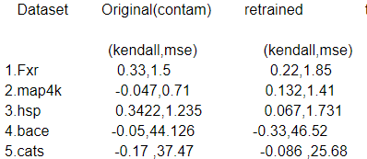
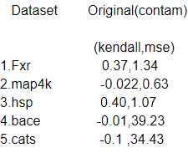
Testing Deep Affinity on D3R datasets
The first three datasets proteins and compounds were found in the training set so they gave good results,but the compounds of last two data sets were not found in the training set so they gave bad results.
The results were again tested for each data challenge after removing the corresponding proteins to make training set non contaminated.
The right most coloumn contains conatins results of testing datasets by
using average of last five epochs of 600-300-150-50 layer model of
deep affinity as they gave the best results among all other models.

Slide 7
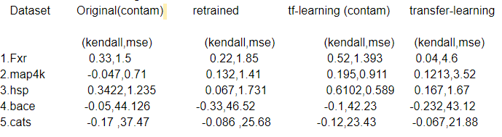
Results after transfer learning
First I have included all the compounds from the training set of that particular protein to do transfer learning . There were some similar compounds in the test set so the results obtained were much better than the results of original model ,but still the results of last two sets were bad because their compounds were not found in deep affinity data set.
Now I removed even the common compounds from test data to do transfer learning and the results obtained were worse.

Slide 8
Problems of transfer learning
Transfer learning gave good results when all the compound pairs of the protein from training set are used but when common compound pairs were removed they gave bad results because the compounds with which transfer learning is done are not similar to the compounds with which they are tested .Hence it gave bad results on new type of compounds even after varying learning rates and other parameters.
I tried to include compounds from the test set with a different protein for the transfer learning to include some information of testing compounds without including the same protein-compound pair present in the test set. But such protein compound pairs were very less in the deep affinity training set and most of the compounds occurred with the same protein in training set which are used for D3R data challenges.

Slide 9
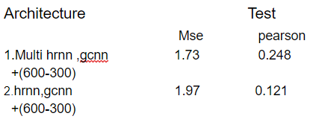
Results of other architectures on deep affinity
Using multi channel hrnn with solvent exposure and secondary structure gave better results than just using hrnn on fasta sequence but it longer time to train and the overall results compared to sps reprsesentations weren’t good.

Slide 10
THANK YOU

